Slide 1
RA Technical Onboarding DIME Best Practices in quantitate data work and documentation
Kristoffer Bjarkefur
Luiza Andrade
Benjamin Daniels
November 2017

Slide 2
How your code is a tool for the whole project?

Slide 3
Think reproducible
All of DIME’s data work should be reproducible. That we should be able to replicate every step of it
This makes collaboration within teams and project turn over smoother, but is also extremely important as part of the research process
The research output is not just a paper or report, but whole process. That means codes, data, documentation are just as important as the final text

Slide 4
Excel vs. Stata
Can I use Excel?

Slide 5
The main reason we use Stata or R
In Excel you make changes directly to the data and save new versions of the data set
In Stata and R your code is the instruction to get from the raw data to the final analysis. Instead of saving versions of the data, we save those instructions in a do-file or an R-script

Slide 6
Your code is an output
Many RAs come to DIME thinking that the code is a mean to an end, but my main point of this session is that your code is equally as much an end as a table or a written report is!

Slide 7
Coding difference Academia vs. DECIE
In academia:
Being correct is the only thing that matters
At DIME
Correct is equally important as in academia
Past, current and future team members contribute to the same code, and therefore we need to standardize how we code, and focus on skills for coding as a team

Slide 8
Inductive vs. Deductive
Learning how to code inductively:
I saw someone using this code for this – therefore I am using the same code
Copying undocumented code without understanding it
Learning how to code deductively:
What are the reasons someone coded a task a certain way? Does those reasons apply to you as well?
Read documentation to understand what commands do and how they are intended to be used

Slide 9
File naming conventions
Never, ever save any data files or do-files in the folder using any variation of these formats:
endline_data_new.csv, endline_data_old.csv
baseline_clean_v1.dta, baseline_clean_v2.dta etc.
Data_cleaning_June8.do
Exception: Outputs (tables, graphs, documentation) can be good practice to date
Syncing software (dropbox, box) have version control

Slide 10
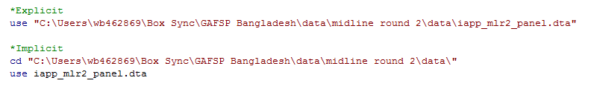
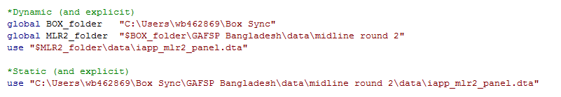
Explicit and dynamic file paths
Explicit vs. implicit file paths
Dynamic vs. Static file path

Slide 11
Coding Styles

Slide 12
White Space. Stata does not distinguish between one empty space and many empty spaces, or one line break or many line breaks. It makes a big difference to the human eye and we would never share a Word document, an Excel sheet or a PowerPoint presentation without thinking about white space - although we call it formatting
Is this slide easy to read?

Slide 13
White Space
Stata does not distinguish between one empty space and many empty spaces, or one line break or many line breaks
It makes a big difference to the human eye and we would never share a Word document, an Excel sheet or a PowerPoint presentation without thinking about white space – although we call it formatting

Slide 14
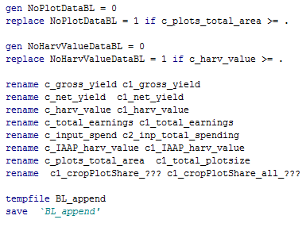
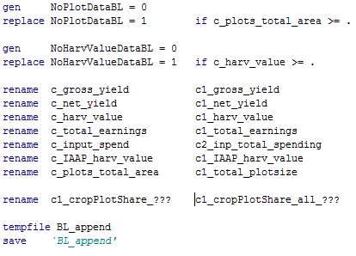
Vertical lines

Slide 15
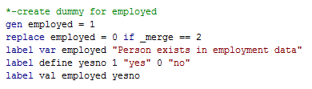
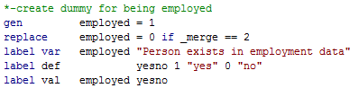
Vertical lines

Slide 16
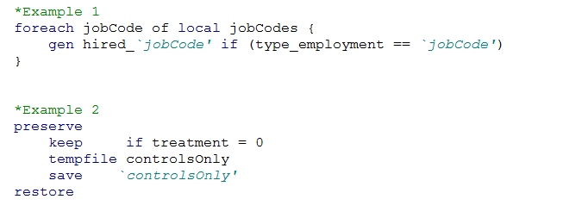
Indentations
Makes code much more readable!
Use for preserve/restore, loops and all other commands with curly brackets

Slide 17
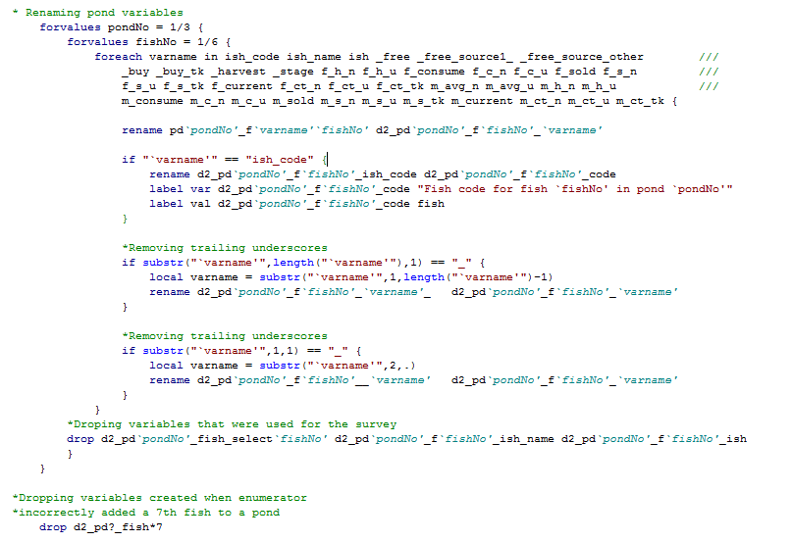

Slide 18
Break up long rows of code
One should never have to scroll horizontally to be able to read code
Two recommended ways to break up lines:
///
Everything on the same row will be interpreted as a comment and the following row will be interpreted as if it was the same row
Good for breaking a long line of code into a few rows
# delimit ; - # delimit cr
Everything between # delimit ; and # delimit cr is executed as one line unless it is manually specified using a semicolon
Good for breaking a very long line of code into many rows

Slide 19
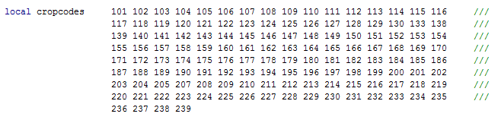
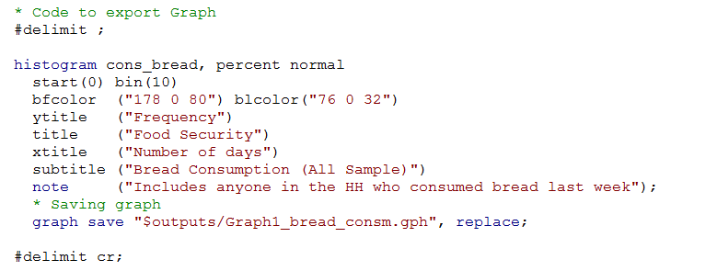
Example of row breaks

Slide 20
Comments
Two purposes:
Tell the reader where you do what
Tell the reader why you do what you do
Purpose 2 makes the difference between good and ok usage of comments, since purpose 1 can often be read from the code

Slide 21
Different types of comments
/* comment */
Used for long comments or to explain many lines of code in the following section
* comment
Used to explain what happens on the following few rows
// comment
Used to explain the same line of code

Slide 22
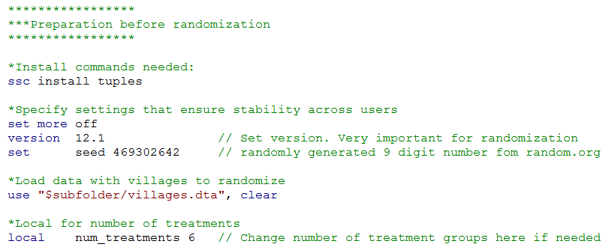
Example of comments

Slide 23
Macros: Local and Global
You all know them – but why do both exist?
Difference in scope – Use them appropriately according to scope
Only define globals in the master do-file. Use locals everywhere else

Slide 24
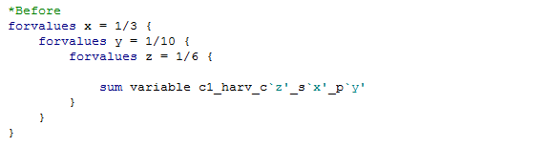
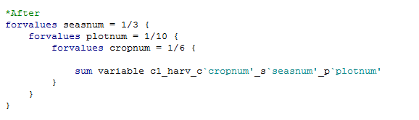
Macros: naming convention
Always give a local or a global a name where the reader can tell what it represents

Slide 25
Tips for usages of locals
Use locals tot shorten variable names and make them more explanatory

Slide 26
Become more exact in your coding

Slide 27

Help files
Get in the habit of using the help file as often as possible!
Even with familiar commands, always more to learn
Help files are only summaries of the reference manual
coding practices, common mistakes, alternative approaches
Access the reference manual by clicking:

Slide 28
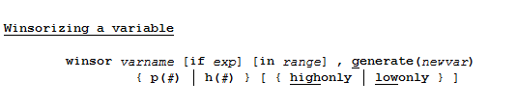
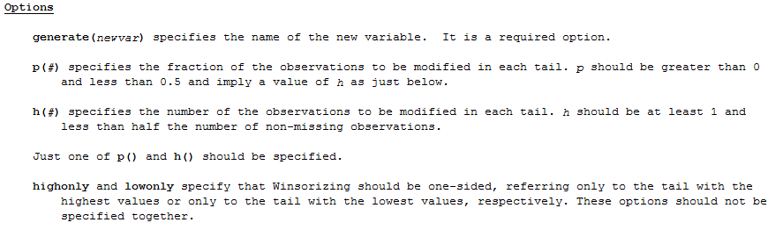
Example of help file

Slide 29
Syntax used in help files
Varlist/varname
Options
[ … ] – Optional
{ … | … } – Use either or
regress – Shortest accepted abbreviation underlined
Sometimes customized names are used in the syntax, those names are always explained below

Slide 30
Structure of help files
All help-files follow the same structure. The most useful are:
Syntax: How to enter the command
Menu: Where to find it in drop down menu
Options: Syntax and explanation of options
Examples: Examples on how to specify the command
Saved results: First step to code Stata dynamically
Many commands are related and share help file:
Drop/keep, decode/encode

Slide 31
Help file usage and coding knowledge
Usage of help files
The Valley of Hubris
Knowledge of coding

